Slide 1
Matter:
Classification of Matter

Slide 2

Concept Targets:
Identify, define and classify types of matter
  Substance
  Elements
  Compounds
  Mixtures
Recognize various techniques that can be used to separate matter
Evaporation | Filtration
Distillation | Chromatography

Slide 3
Chemistry and Matter
Chemistry is the study of MATTER, the changes matter undergoes, and the ENERGY associated with those changes.
Matter is physical material of the universe that has definite MASS and occupies a definite VOLUME.
Matter cannot be created or destroyed.

Slide 4
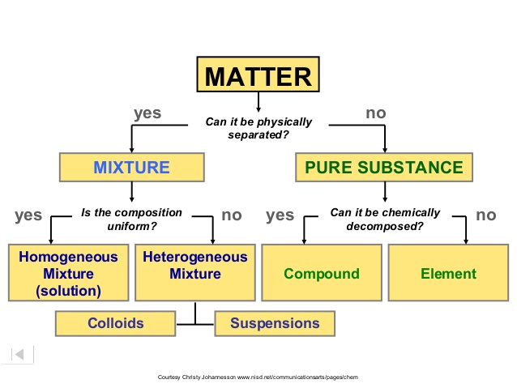
Classification of Matter
Matter can be CLASSIFIED into 4 based on physical and chemical separation or based upon the kind of particles and how the particles (atoms) are arranged.

Slide 5
Substance Definition
Substances (Or Pure Substances)
– SAME composition ( Pattern) of material throughout –Each piece has the same CHEMICAL makeup.
–CANNOT be separated by physical means.
–All substances have a FORMULA.

Slide 6
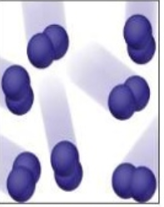
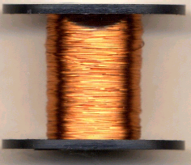
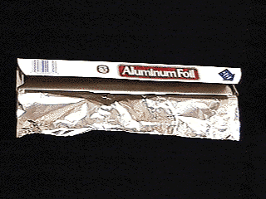
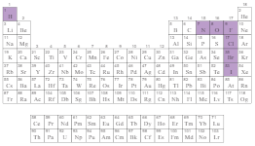
Elements
  pure substance
  cannot be physically or chemically separated into simpler substances
  Symbol of element contains one letter or two letters
  Composed of identical atoms
(Atom: smallest unit of an element that has all the characteristic properties of an element)
  Exception: Seven elements the building blocks are diatomic molecules: H₂, N₂ , O₂, F₂, Cl₂, Br₂ , I₂
  EX: copper wire, aluminum foil, any element from the periodic table
Cl₂

Slide 7
2. Compounds
  pure substance ( not physically separable)
  composed of 2 or more atoms that are chemically combined in a FIXED ratio. (chemical FORMULA)
  properties differ from those of individual elements
  can be separated by chemical means
  represented by chemical formula: subscript shows how many atoms of each element are present
  molecule: composed of two or more atoms that has all the characteristic properties of the compound
  EX: table salt (NaCl), Pure H₂O

Slide 8
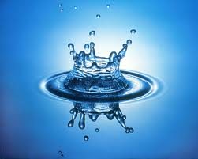
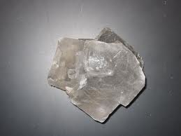
Compounds
H₂O
NaCl

Slide 9
Mixtures
2. Mixtures –
_ composed of TWO OR MORE pure substances. _Mixtures CAN be separated or broken apart by physical means.
_Mixtures are classified into two types
Depending whether the particles are uniformly dispersed ( Homogeneous) or not uniformly dispersed ( Heterogeneous)

Slide 10
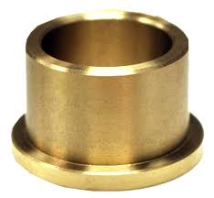
3. Homogenous Mixtures
( Solutions)
Uniform composition and appearance ( all part looks the same)
very small particles
particles don’t settle
EX: rubbing alcohol, alloy(brass, bronze,18 carat gold), store bought milk, tap water
Note: ALLOY is a mixture of metals that are not chemically combined with each other

Slide 11
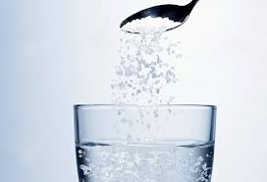
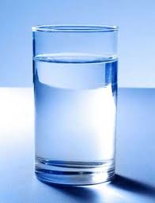
Homogeneous Solution
H₂O and NaCl

Slide 12
4. Heterogeneous Mixtures
Does not have uniform composition or appearance
medium-sized to large-sized particles
particles may or may not settle
EX: fresh-squeezed
lemonade, blood, juice with pulp

Slide 13
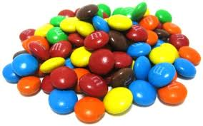
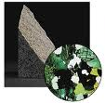
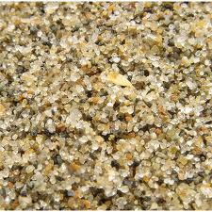
Heterogeneous Mixture

Slide 14
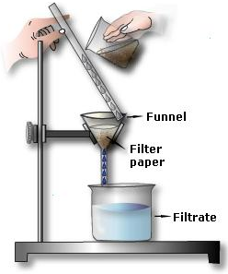
Physical Separation Techniques for separating components in a mixture
Filtration
- Process by which a precipitate (a solid) is recovered from a mixture.
- Used for separating heterogeneous mixtures of liquid and solids.

Slide 15
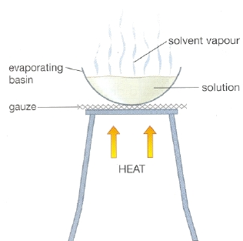
Physical Separation Techniques
Evaporation
- Surface transition of a liquid to a gas
- A homogeneous mixture of salt water can be separated into salt and water by heating it. The salt is left in a dish.

Slide 16
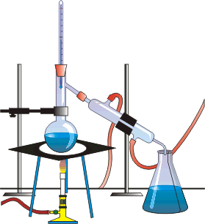
Physical Separation Techniques
Distillation
- Separation is based on boiling point differences.
- Used to separate a solid from a liquid or 2 liquids with varying boiling points.

Slide 17
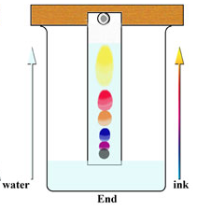
Physical Separation Techniques
Chromatography
- Process to which components of certain mixtures are separated because of differences in solubility.

Slide 18
Practice
1. Circle all the elements and place a box around the compounds below. On the line, record the number of different symbols within the species.
Mg ___ H₂SO₄ ___ CO ___ Cu ___ Br₂ ___
2. Above in #1, for each species circled above (an element), how many total symbols are listed?
3. Above in #1, what is the minimum number of symbols that must be present in order for a species to be considered a compound?
1
3
2
1
1
1
2

Slide 19
Practice
4. A student adds sand into a beaker containing water, stirs the sample, and observes the sand settle to the bottom. What type of solution did the student make, and how can this student separate the sand from the water?
5. The instructor asks a student to separate a mixture of two liquids, water and ethanol. What type of solution did the student make, and how can this student separate the two liquids?
Heterogeneous Mixture
Filtration
Homogeneous Mixture
Distillation

Slide 20


